Slide 1
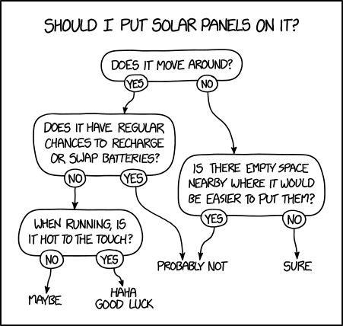
Decision trees
Gosztolya Gábor
Szegedi Tudományegyetem
Informatikai Intézet
2023 / Mar / 30
This works for a surprising range of sunlit things, including rooftops (sure), highway surfaces (probably not), sailboats (maybe), and jets, cars, and wild deer (haha good luck).

Slide 2
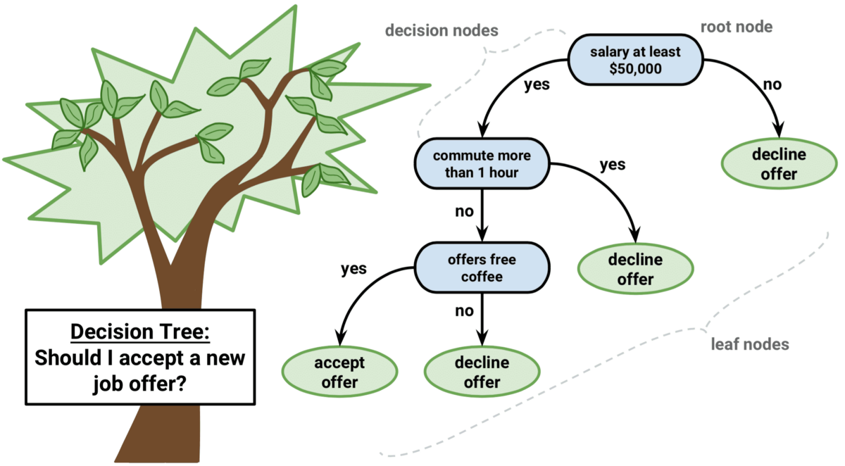
Decision trees
Originally invented for concept learning (two-class classification) over discrete features
But later it was extended to more classes
And also to continuous features (here also called “attributes”)
Also closely related to the learning of logical formulas

Slide 3
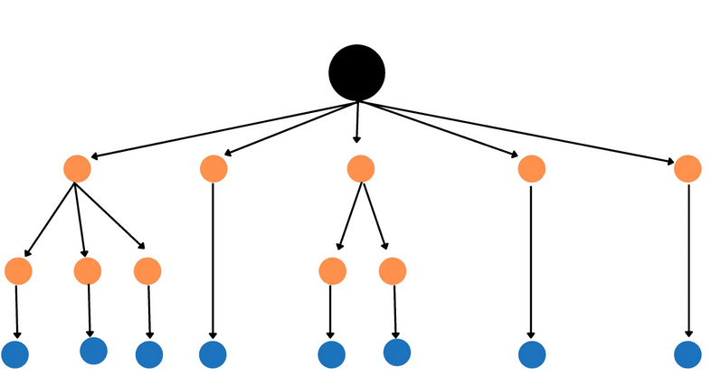
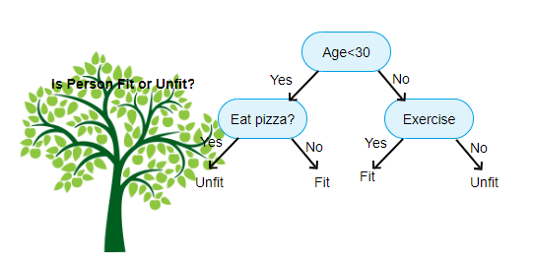
Decision trees #2
It has no strict mathematical background, it is based on Occam’s heuristic – a simpler explanation usually generalizes better
It seeks to create a compact and consistent representation for the training data
It was shown (later) that compression is closely related to learning, so creating a compact representation is indeed a good heuristic
The representation will be a decision tree
We will try to build the smallest possible decision tree

Slide 4
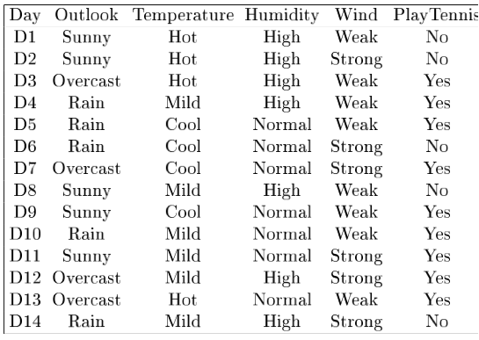
Example task

Slide 5
Representation by a logical formula
We can represent each Yes row by a conjuction:
(Outlook=Overcast) ∧ (Temperature=Hot) ∧ (Humidity=High) ∧ (Wind=Weak)
And we can connect these by disjuctions:
If the table contains no contradicting examples, then the formula is true for all positive examples, and negative for all negative ones
→it is consistent with the training data
(Outlook=Overcast) ∧ (Temperature=Hot) ∧ (Humidity=High) ∧ (Wind=Weak)
∨
(Outlook=Rain) ∧ (Temperature=Cool) ∧ (Humidity=High) ∧ (Wind=Weak)
∨
…

Slide 6
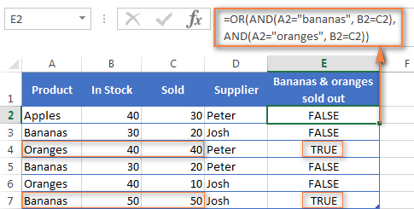
Representation by a logical formula #2
So the formula is consistent with the training data
We also want the formula to be as small as possible, as this is our heuristics for good generalization
The same truth table may be represented by many logical formulas!
How to find the (a) smallest one?

Slide 7
Reducing the logical formula
How can we reduce the size of a formula?
We can remove unnecessary evaluations:
…is equivalent to:
(… if the Wind attribute has these two possible values…)
(Outlook=Rain) ∧ (Temperature=Hot) ∧ (Humidity=High) ∧ (Wind=Weak)
∨
(Outlook=Rain) ∧ (Temperature=Hot) ∧ (Humidity=High) ∧ (Wind=Strong)
(Outlook=Rain) ∧ (Temperature=Hot) ∧ (Humidity=High)

Slide 8
Reducing the logical formula #2
How can we reduce the size of a formula?
When two or more rows contain the same sub-formula, we should avoid evaluating them two or more times:
The idea of joint evaluation leads to the decision tree representation
…so (so far) we have Yes/No (True/Fase) binary labels
(Outlook=Rain) ∧ (Temperature=Hot) ∧ (Humidity=High) ∧ (Wind=Weak)
∨
(Outlook=Rain) ∧ (Temperature=Hot) ∧ (Humidity=Normal) ∧ (Wind=Strong)

Slide 9
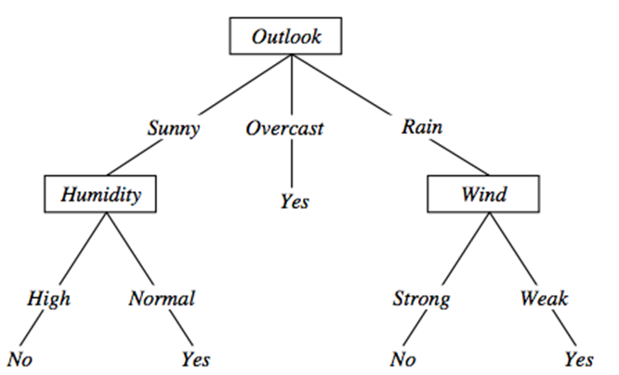
Representation by a decision tree
Each path from the root to a Yes leaf corresponds to a conjunction
The whole tree represents the disjunction of these paths
So the above tree represents the formula:
This formula is also consistent with the training examples
But it is much smaller than the disjunction of conjunctions created earlier
((Outlook=Sunny) ∧ (Humidity=Normal)) ∨ ((Outlook=Overcast)) ∨
((Outlook=Rain) ∧ (Wind=Weak))

Slide 10
Construction of decision trees from data
We saw how the decision tree classifies an example
We saw that a decision tree corresponds to a logical formula
So, instead of learning formulas, we can learn decision trees directly
But how can we learn decision trees?
That is, given the table with the examples, how can we automatically create a decision tree?

Slide 11
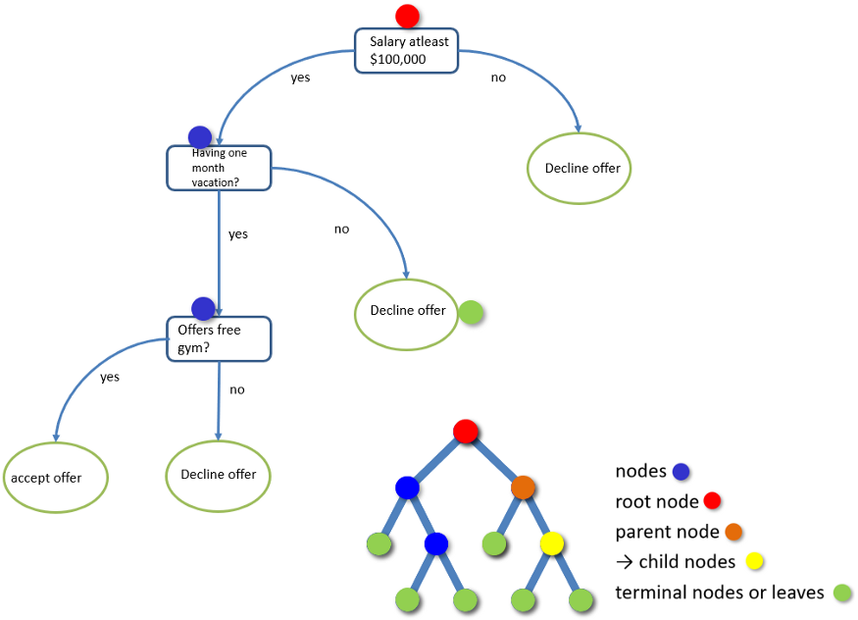
Construction of decision trees from data #2
Our expectations:
The tree must be consistent with the training examples
But, at the same time, we would like to build a small tree (Occam’s razor)
Next we present the ID3 tree construction method (Quinlan, 1986)
It builds the tree recursively, from the root towards the leaves
It seeks to build a small tree by using a greedy attribute selection strategy

Slide 12
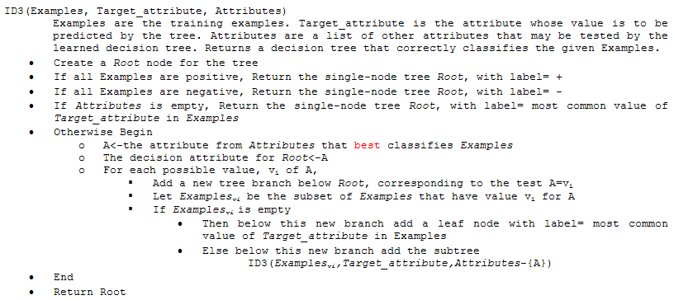
The ID3 algorithm
Create a new leaf
Choose the attribute
Create a new branch

Slide 13
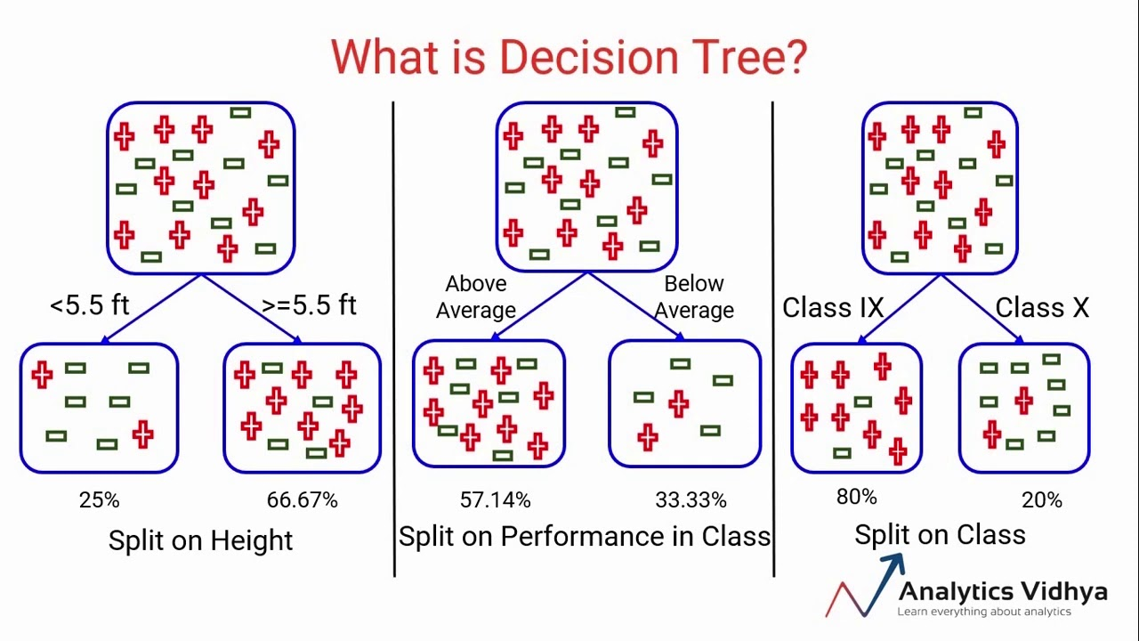
The ID3 algorithm – summary
1) We select an attribute for each node
How?
Not trivial at all…
2) We create branches according to the possible values of this attribute
3) We also split the data items according to the actual value of this attribute
4) We recursively repeat the algorithm for each branch and for the corresponding data items

Slide 14
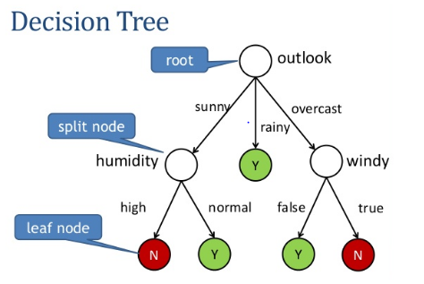
Stopping conditions
All the data in the branch are positive
Create a leaf with label positive
All the data in the branch are negative
Create a leaf with label negative
No data in the branch
Create a leaf with the most common label at the parent node
No more attributes to test
This means that the data in this branch is contradictory!
Create a leaf with the most common label

Slide 15
How to select the attribute for a node?
We want to build a small (shallow) tree
Building stops when the data in all branches is “clean”
That is, the positive and negative examples do not mix
Our heuristics will be to chose the attribute that gives the largest decrease in the “impurity” of the data
There are many possible ways to formally define the impurity

Slide 16
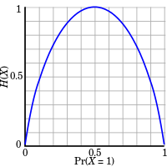
How to select the attribute for a node? #2
One possibility is to use the notion of entropy
Shannon entropy:
We will define the information gain as the expected reduction of entropy
At each node, we will calculate the information gain for each attribute, and select the one that gives the largest information gain

Slide 17
Selecting attribute by using entropy
We will define information gain by the decrease of entropy:
We calculate information gain for each possible attribute in each node, and choose the one for which this gain is maximal
Entropy (S) = - p₊log₂p₊ - p–log₂p– [note: 0 log₂0 = 0]
p₊ is the ratio of positive examples (0 ≤ p₊ ≤ 1)
p– is the ratio of negative examples (0 ≤ p– ≤ 1)
Entropy ([14+, 0–]) = – 14/14 log₂ (14/14) – 0 log₂ (0) = 0
Entropy ([9+, 5–]) = – 9/14 log₂ (9/14) – 5/14 log₂ (5/14) = 0,94
Entropy ([7+, 7– ]) = – 7/14 log₂ (7/14) – 7/14 log₂ (7/14) = 1,0

Slide 18
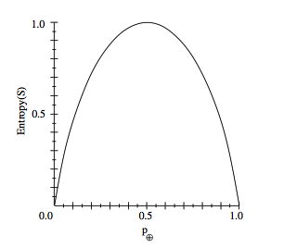
Entropy (for two classes)
In general, the shape of the entropy curve looks like this: (on the right)
Note that: p₊ = 1- p₋
The entropy becomes maximal (1.0) if p₊ = 0.5 and p₋ = 0,5
…so that the positive and negative examples are maximally mixed
This is why it can be used as a measure of “impurity”

Slide 19
Information Gain
The information gain is the expected reduction of entropy caused by partitioning the data according to the values of the given attribute:
Where v are the possible values of attribute A, and |S_{v}| is the number of examples in the branch that belongs to value v
At each node with the given S subset of data, we calculate this gain for all attributes A, and select the one that maximizes the above Gain(S,A)

Slide 20
Example for information gain
Entropy: ;
Example: Entropy(S) = -(29/64) log₂(29/64) - (35/64) log₂(35/64) ≈ 0,994
[29+,35-]
A₁=?
A₂=?
[29+,35-]
True
False
True
False
[21+, 5-]
[8+, 30-]
[18+, 33-]
[11+, 2-]

Slide 21
Example for information gain #2
Entropy([21+,5-]) = 0.71
Entropy([8+,30-]) = 0.74
Gain(S,A₁)=Entropy(S)
-26/64*Entropy([21+,5-])
-38/64*Entropy([8+,30-])
= 0.27
Entropy([18+,33-]) = 0.94
Entropy([11+,2-]) = 0.62
Gain(S,A₂) = Entropy(S)
-51/64 * Entropy([18+, 33-])
-13/64 * Entropy([11+, 2-])
= 0.12
[29+,35-]
A₁=?
A₂=?
[29+,35-]
True
False
True
False
[21+, 5-]
[8+, 30-]
[18+, 33-]
[11+, 2-]

Slide 22
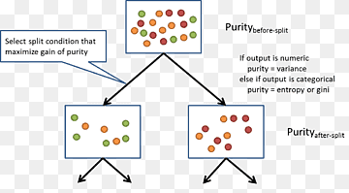
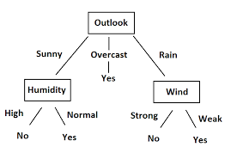
Main properties of ID3
It was invented for discrete features
involving binary features
It does not restrict the hypothesis space in advance
Has no “modeling assumption”
So it can create a consistent decision tree for any dataset that contains no contradicting samples
But it has a “preference bias”
That is, it tries to put the attributes with high information gain close to the root

Slide 23
Main properties of ID3 #2
The decision for the best attribute is greedy, without backtracking
So the resulting tree is not guaranteed to be optimal (the smallest possible)
The result is easily interpretable for humans
e.g. directly displayed or converted to a set of IF-THEN rules
Not too sensitive to noise (erroneous labels)
as the decision for the attributes (the entropy measure) is statistical (uses all data in the branch)
Though it becomes more and more sensitive as we get closer to the leaves

Slide 24
The pruning of decision trees
As we move down in the decision tree, fewer and fewer data samples remain in each branch
We make decisions based on fewer and fewer samples, so individual samples have a larger and larger influence
Chance of making a wrong decision (due to e.g. a noisy example) increases
If the data contains no errors (e.g. incorrectly labeled samples), the tree building stops only with a perfect decision tree (train error is 0%)
This tree is likely to be overly complex, with many of the leaves assigned based on only a couple of examples
It will quite probably overfit the training data
These are the two main reasons for pruning the tree

Slide 25
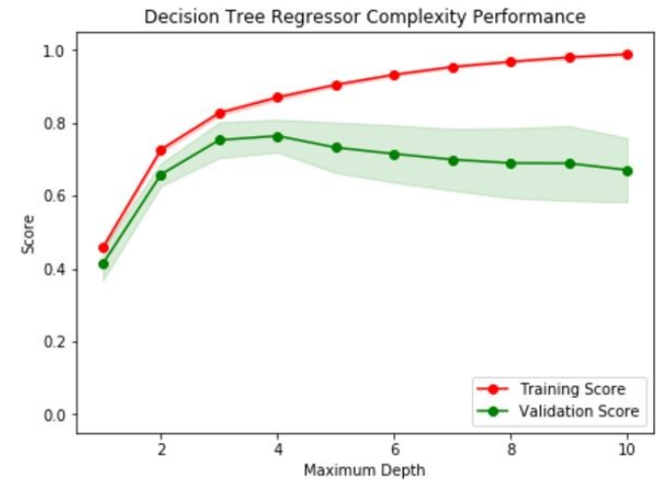
Overfitting example

Slide 26
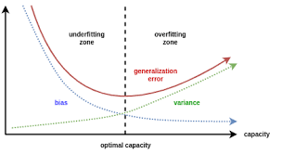
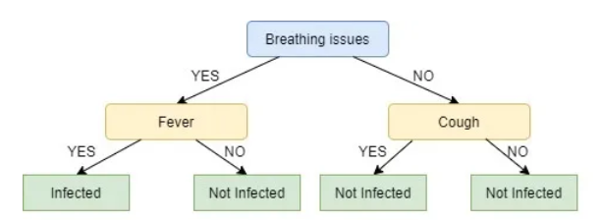
Pruning of decision trees
There are two main approaches to reduce overfitting
In both cases we reduce the size of the tree
Approach #1: early stopping of tree building
E.g. do not split a node further when the number of examples in the given branch is below a given limit
Assign a leaf corresponding to the majority of labels instead

Slide 27
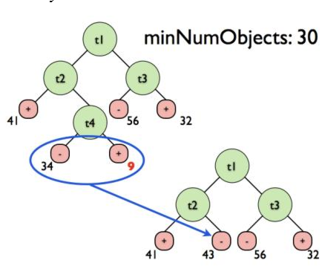
Pruning of decision trees #2
Approach #2: allow the tree to build fully, then post-prune the tree
Try to prune each node by replacing it by a leaf that is labeled according to the majority of labels
Measure the effectiveness of pruning on a validation set
Remove the node that gives the largest increase in the classification accuracy on the validation set
Stop pruning when there is no increase in accuracy

Slide 28
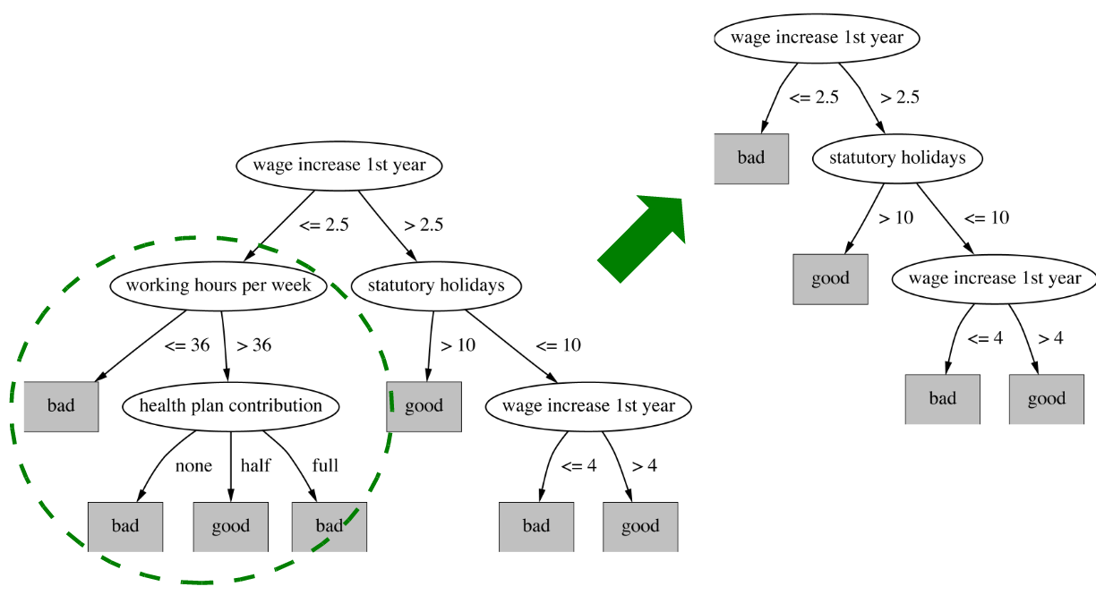
Pruning example

Slide 29
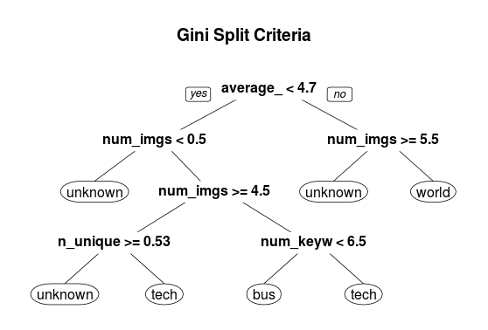
Extensions of decision trees
Extension to continuous attributes
…since originally it handled only categorical ones
Alternative measures of information gain
…e.g. variance impurity, Gini impurity (/index)
Handling examples with missing attributes
Handling examples with different costs
Most of these improvements are present in (one of) the most popular implementation of decision trees called C4.5 (Quinlan, 1993)

Slide 30
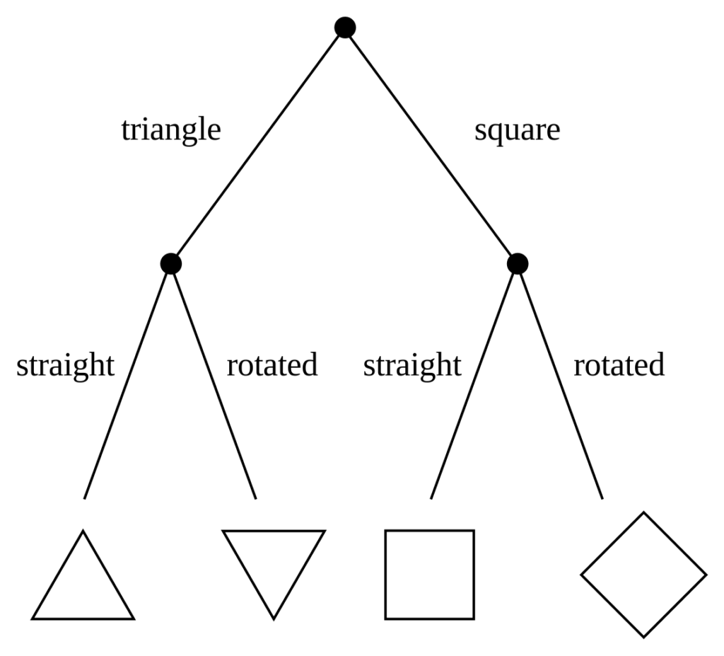
Extension to more classes
Fortunately, entropy is defined for more classes
Let X be a discrete random variable with c possible values. Then its entropy is defined as
With this, we can easily modify the information gain function to work for more classes.
The other parts of the algorithm require only minimal modifications

Slide 31
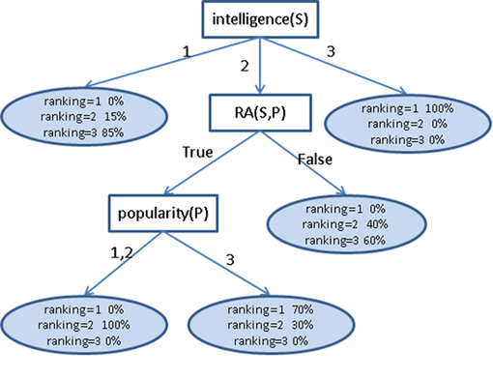
Extension to probability estimation
We can return posterior estimates, too
E.g. for controversial examples
Recall that the (pruned!) tree assigns labels to leaves based on the majority of the samples in the given branch
We can easily modify this to return probability estimates for each class
Estimated as the ratio of the samples belonging to the given task within the branch

Slide 32
Extension to continuous attributes
We can discretize a continuous variable using thresholds like:
This way the decision tree building algorithm works just as before
But how can we select the thresholds automatically?
Example with continuous temperature values
Let’s order the examples according to the values of the attribute:
Possible thresholds: mean of the values where the label changes
We add the conditions (Temperature<54), (Temperature>54), (Temperature<85), (Temperature>85) to the attribute set
(Temperature>10) ∧ (Temperature<30)

Slide 33
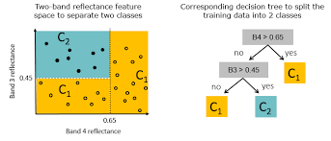
Extension to continuous attributes #2
In the case of continuous attributes the decision tree represents the classes with a union of rectangles parallel to the axes

Slide 34
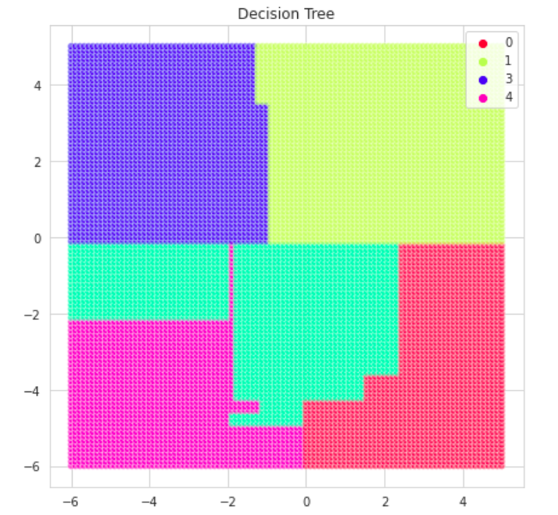
Extension to continuous attributes #3
So theoretically it can approximate regions with arbitrary shape
Including disconnected regions
However, it is not really efficient
Primarily, it is best for discrete features or mixed features

Slide 35
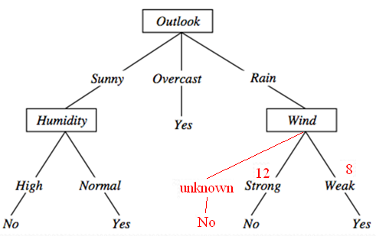
Extension to missing attributes
What can we do if a feature is missing during testing?
During tree building, we count the number of occurrences for each branch
After building the tree, we create an additional “unknown” path, and label it with the label of the most frequent path

Slide 36
Extension to missing attributes #2
And if there are missing features during training (tree building)?
…we assume that these correspond to the majority of the samples
A strategy for handling this case:
Let’s build the tree without using the samples that have missing features
From the occurrences of each branch we can create probability estimates (similarly to the method shown above)
We assign the most probable value to each missing feature
We re-build the tree by using also the samples with the missing features
There are many other methods for this – more or less sophisticated

Slide 37
Refining the information gain function
The information gain fwill prefer attributes that have many values
It will cause problems when some attributes have many more possible values than others
Extreme example: consider the playTennis function with the Date added as an attribute to the training samples
It would be selected as the root, resulting in a very broad tree that creates too many small branches with very few data in each branch
This tree would strongly overfit the training data, and generalize poorly to the test data
We would like to modify the information gain so that it penalizes such attributes

Slide 38
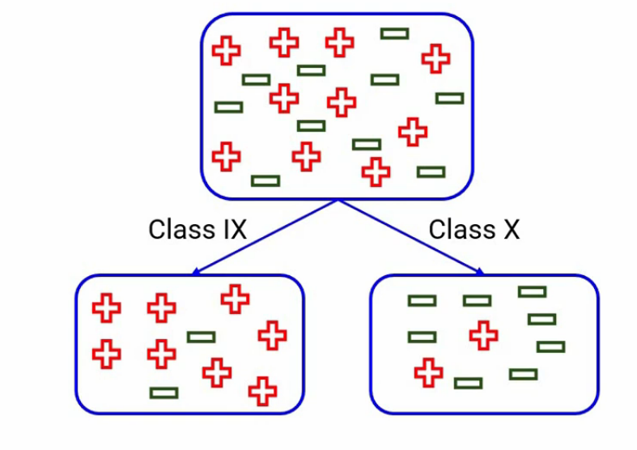
Classification and regression trees (CART)
This is the other most popular implementation besides C4.5
The main difference is that instead of entropy, is uses the Gini index as the impurity measure
„Gini impurity is a measure of how often a randomly chosen element from the set would be incorrectly labeled if it was randomly labeled according to the distribution of labels in the subset.”

Slide 39
Classification and regression trees (CART)
This is the other most popular implementation besides C4.5
The main difference is that instead of entropy, is uses the Gini index as the impurity measure
„Gini impurity is a measure of how often a randomly chosen element from the set would be incorrectly labeled if it was randomly labeled according to the distribution of labels in the subset.”

Slide 40
Gini impurity
Gini impurity:
And the average Gini index is calculated as:
(the individual Gini values weighted with the no. of samples)
Finally, the „Gini gain” is calculated similarly to the information gain
But it is not necessary (larger Gain ←→ smaller Gini impurity)
Other difference with CART: it can use multivariate decisions
Decisions are built on more attributes (at the same time!), not on just one

Slide 41
Example for Gini Impurity (NOT gain!)
Gini([21+,5-]) =
= 1 - ((21/26)² +(5/26)²) = 0,31
Gini([8+,30-]) =
= 1 - ((8/38)² +(30/38)²) = 0,33
Weighted Impurity =
26/64*Gini([21+,5-]) +
38/64*Gini([8+,30-])
= 0,32 ← less!
Gini([18+,33-]) =
= 1 - ((18/51)2 +(33/51)2) = 0,46
Gini([11+,2-]) =
= 1 - ((11/13)2 +(2/13)2) = 0,26
Weighted Impurity =
51/64 * Gini([18+, 33-])
13/64 * Gini([11+, 2-])
= 0,42
[29+,35-]
A₁=?
A₂=?
[29+,35-]
True
False
True
False
[21+, 5-]
[8+, 30-]
[18+, 33-]
[11+, 2-]

Slide 42
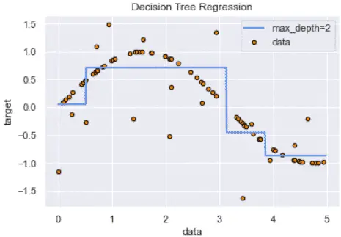
Regression trees
Can we use decision trees for regression?
That is, when the target labels are not classes, but numeric values
Yes, we can, but with modifications
The largest modification: leaf nodes will return the average value of all instances in this leaf
…as we do not have class labels

Slide 43
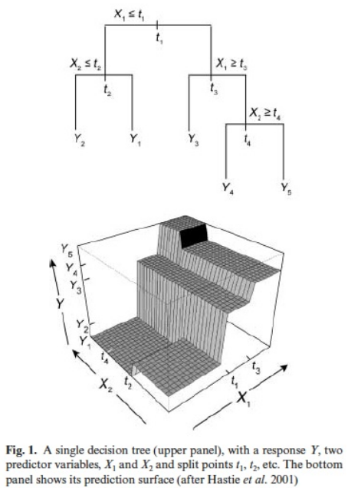
Regression trees #2
Tree building (subset creation) strategy:
We minimize the variance of the values within each subset S_{i}
Splitting criterion:
Standard deviation reduction
…as we still do not have class labels, which would allow us to calculate impurity

Slide 44
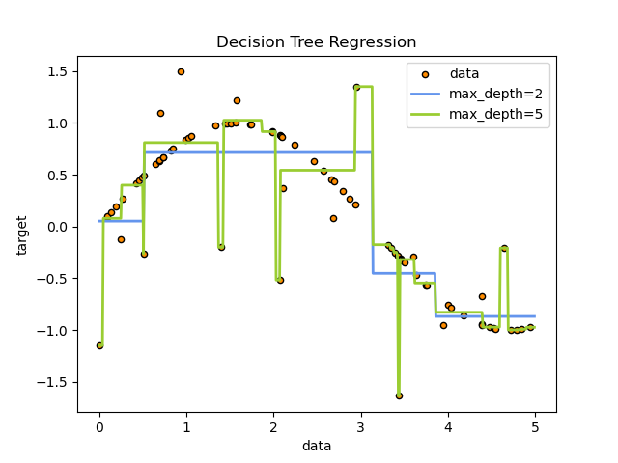
Regression trees #3
Early stopping of tree building
We don’t want single points in each leaf
We stop if the number of examples falls under a given threshold
We stop if the standard deviation falls under a given threshold
Pruning: with numeric error measures, such as mean squared error (MSE)

Slide 45
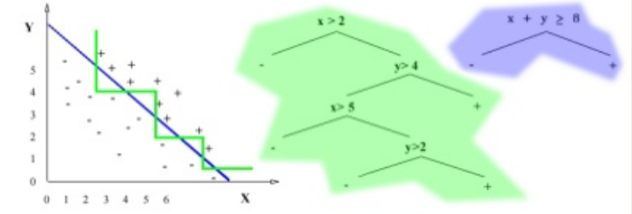
Multivariate decision trees
For continuous features, decisions based on one attribute lead to decision boundaries built from lines parallel to the axes (green color)
We could obtain a much smaller tree if we could create multivariate decisions in each node
These are the so-called multivariate decision trees

Slide 46
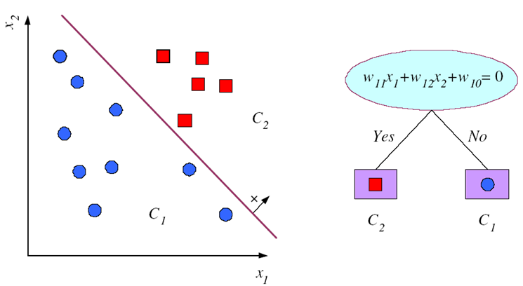
Multivariate decision trees #2
The decisions are formulated as weighted linear combinations of the attributes (see figure)
The decision surfaces are still built from lines, but not necessarily lines parallel with the axes
Unfortunately, the tree-building procedure becomes much more complicated
We have to examine all possible feature combinations
For more details, see: http://legacydirs.umiacs.umd.edu/~salzberg/ docs/murthy_thesis/survey/node11.html

